Slide 1
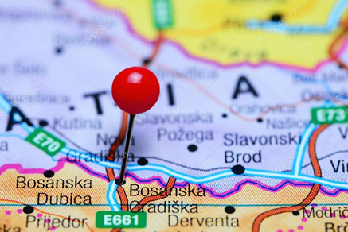
Improving our utility’s performance through participating in D-Leap programs
Sandro Zeničanin
Ivana Torbica
KP ’’Vodovod’’ a.d Gradiška
Vienna, 20.05.2019.

Slide 2
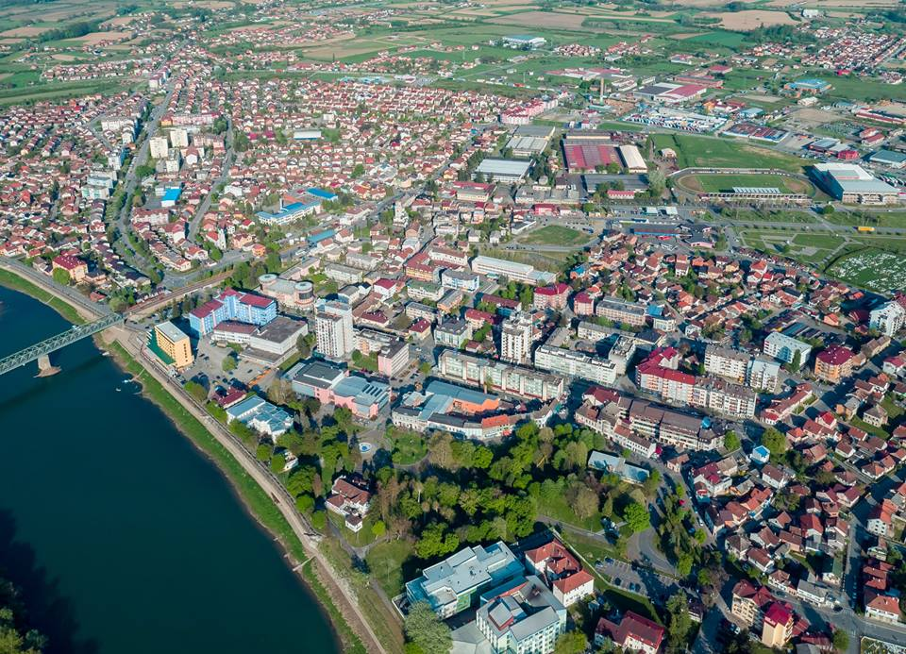
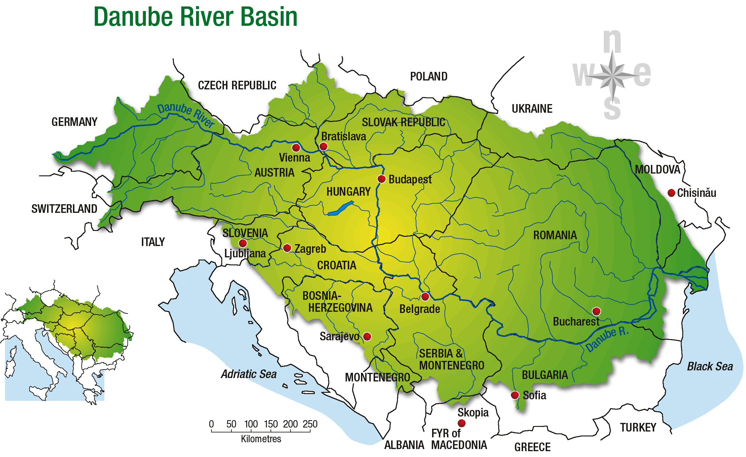
City and municipality Gradiška
Municipality:
762 km²
52 000 inhabitants
covers
Lijevče polje – fertile valley at an average 110 m.a.s.l.
and Potkozarje – mountainous area, up to 300 m.a.s.l.
favorable transport and geographical position
great natural and socio-economic potential
Under Lijevče polje are significant reserves of clean drinking water
Northwestern part of BiH, on the Sava River→ border with Croatia and EU

Slide 3
PU ’’Vodovod’’ a.d. Gradiška
1958
Began the construction of water distribution network
Water tower
1965
1963
First two wells B1 and B3
2009
Joint stock company
Performs the services of water supply, collecting and draining of waste water
4 000 000 m³ of water
1968
Began the construction of sewerage network
1973
Vodovod was founded
Municipal population connected to the system
80 employees
30%
88%
water
sewerage
45 993 residents
17 916 residents
Majory owned by city Gradiška

Slide 4
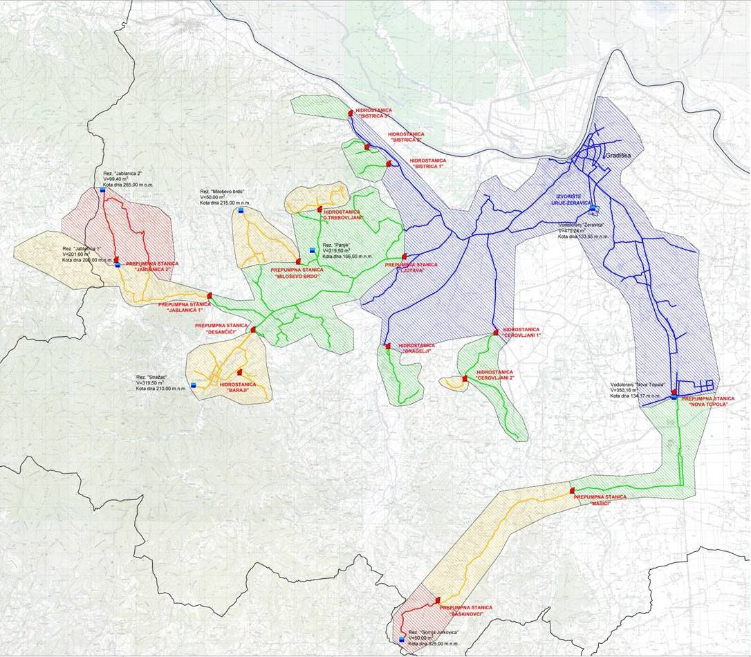
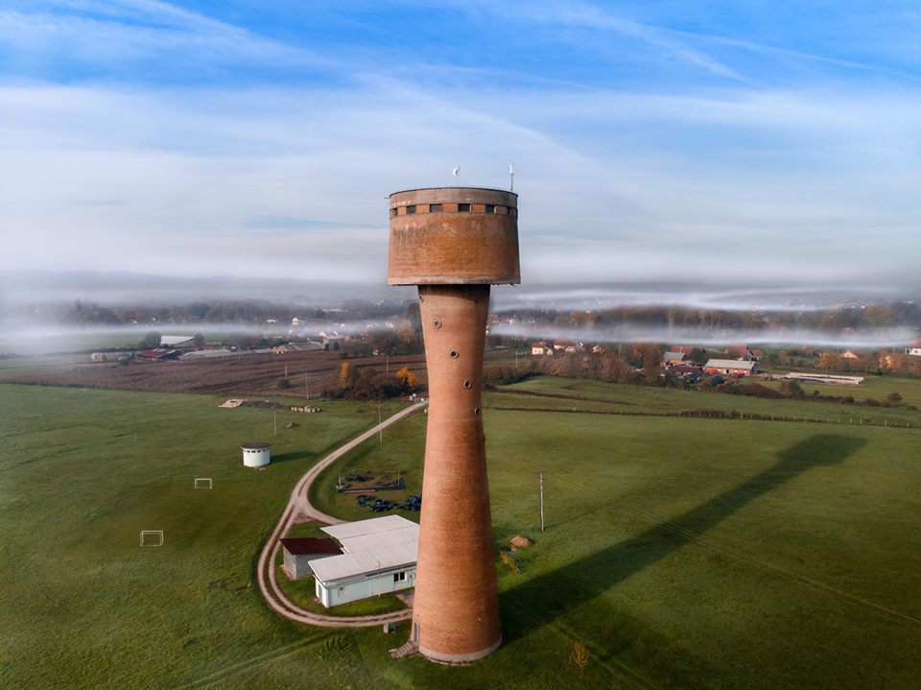
PU ’’Vodovod’’ a.d. Gradiška
- Water and sewerage network -
4 heght zones
I
II
IV
III
Groundwater source Zeravica
Located 2,5 km from town centre and
river Sava, at 90 m.a.s.l.
4 operational wells
total capacity 315 l/s (max 600 l/s)
water tower
V=470m³
Maximal daily water requirement 160 l/s
(hour -250 l/s)
From here►Gravitational distribution of water for users in the first height zone,
and further one with the pumps and reservoirs for users in the second, third and fourth height zone
595 km of water supply network
8 reservoirs
1860m³
16 pumping stations:
- Booster stations
- Pressure vessel stations (hydrofors)
16 905 connections

Slide 5
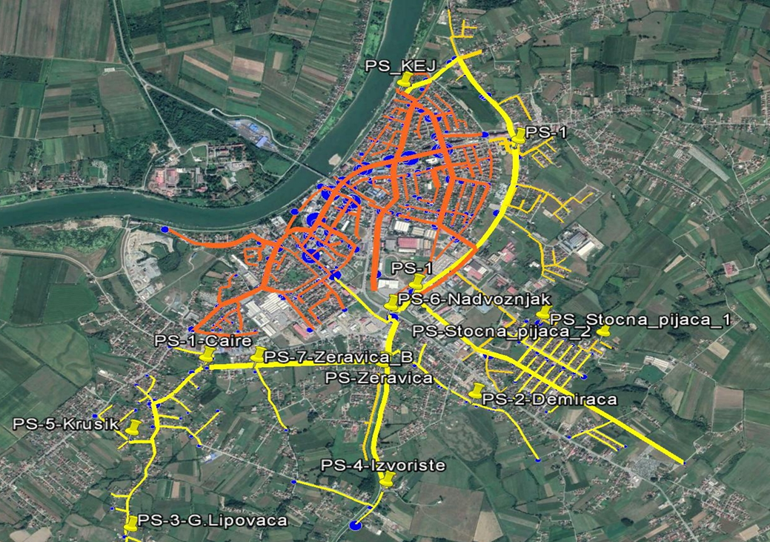
PU ’’Vodovod’’ a.d. Gradiška
- Water and sewerage network -
Combined wastewater collection system (sanitary and stormwater flows)
52 km of sewage network
1 pumping station
13 repumping stations
5972 connections

Slide 6
NRW reduction - The problem -
!
2013
Vodovod began with Benchmarking, tracking and comparing performance indicators
2016
By the end of 2016 (MEG project) – NRW was close to 60%
2017
D-LeaP’s capacity building program Improved Non-Revenue Water management in water utilities
Participating Hub Aquasan Network in Bosnia and Herzegovina
Acknowledging the problem and actively looking for a solution
Passive leakage control
Insufficient trained employees
Only overall system losses

Slide 7
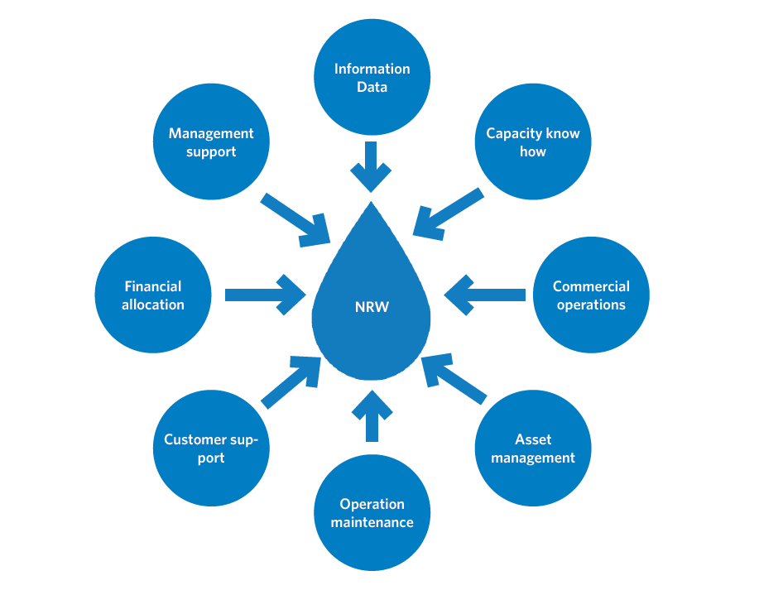
NRW reduction - actions done -
Workshops as well as hands-on excersises with the support of the trainers
Workshops as well as hands-on excersises with the support of the trainers

Slide 8
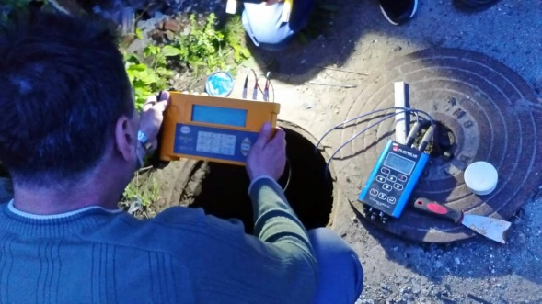
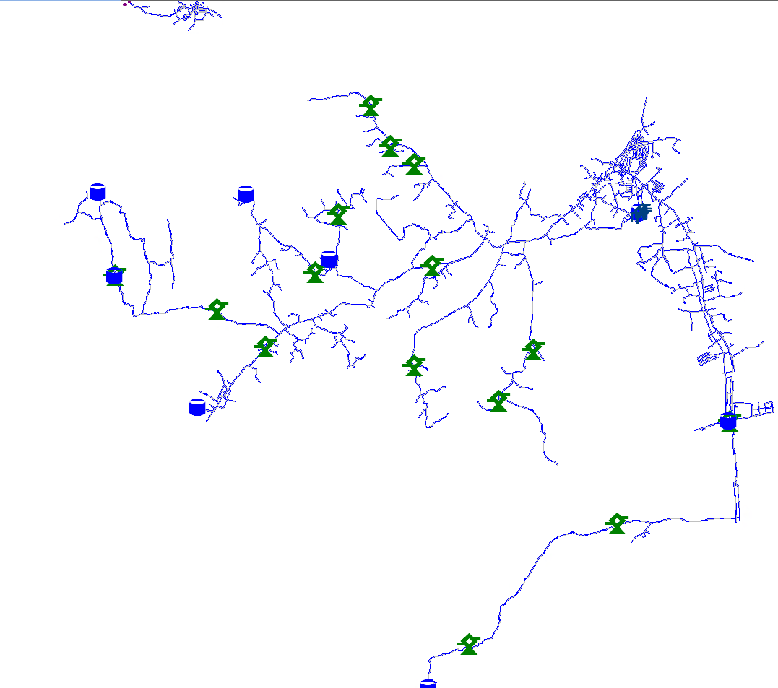
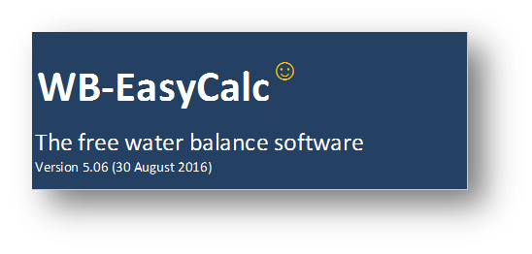
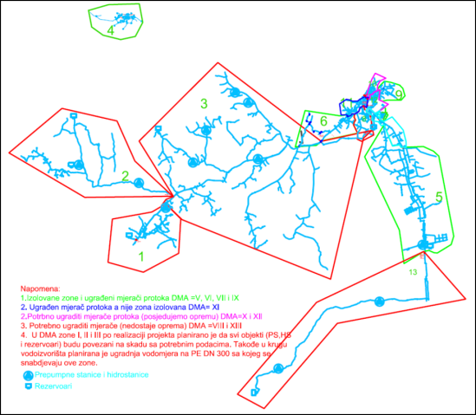
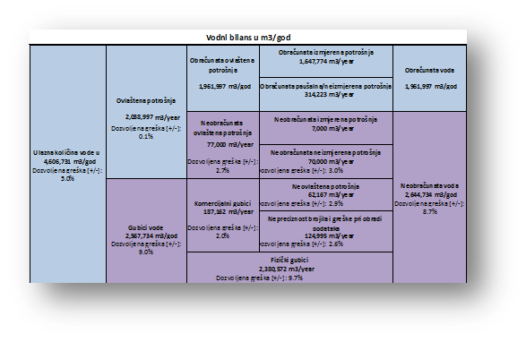
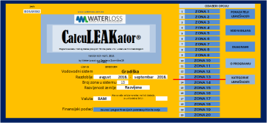
NRW reduction - Measures of change -
End of 2017 → now:
Trained employees
Leak Detection Team and GIS Team
NRW reduction strategy – action plan /yearly/ (within utility’s operational strategy)
Completed main records and
GIS based asset register of the water supply network
Latest available orthophoto map
GIS equipment – GPS device, computers, software
Designed and set up DMA zones that cover complete network
Clear list of water clients, divided by DMA zones
Procurement of NRW and leak detection equipment – bulk meters, data loggers, ultrasonic flowmeter, Geophone, noise loggers
Continious monitoring and water balance analysis
Water balance for DMA Zones and total water balance by IWA methodology
Active leakage control
Great colabration with LSG – signing of PSA

Slide 9
NRW reduction - Results -
NRW reduction almost 10%

Slide 10
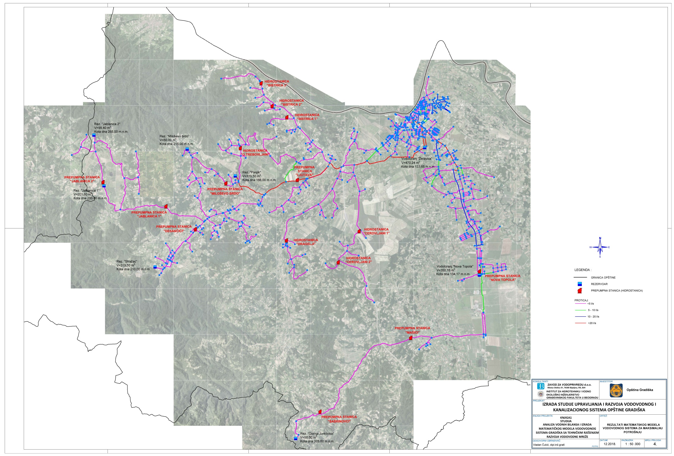
Hydraulic model
Inital measuring and calibration of the model were performed in 2018,
and the complete model is expected by the end of 2019.

Slide 11
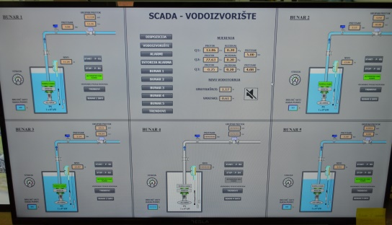
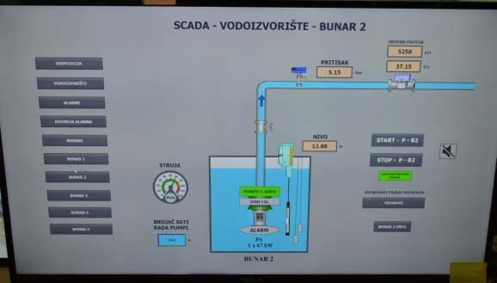
SCADA system and Telemetry
In april 2019 works at Žeravica site rehabilitation were finished (MEG project, november 2018):
Existing water tower rehabilitation
Automated chlorination unit
Groundwater source sanitary protection
Monitoring and control – SCADA system
Among other great advantiges, now we have exact information of amount of produced water, while until now the amount of produced water was estimated on the basis of well pumps operating hours and it’s capacities

Slide 12
Thank You kindly
for Your attention!

